Slide 1
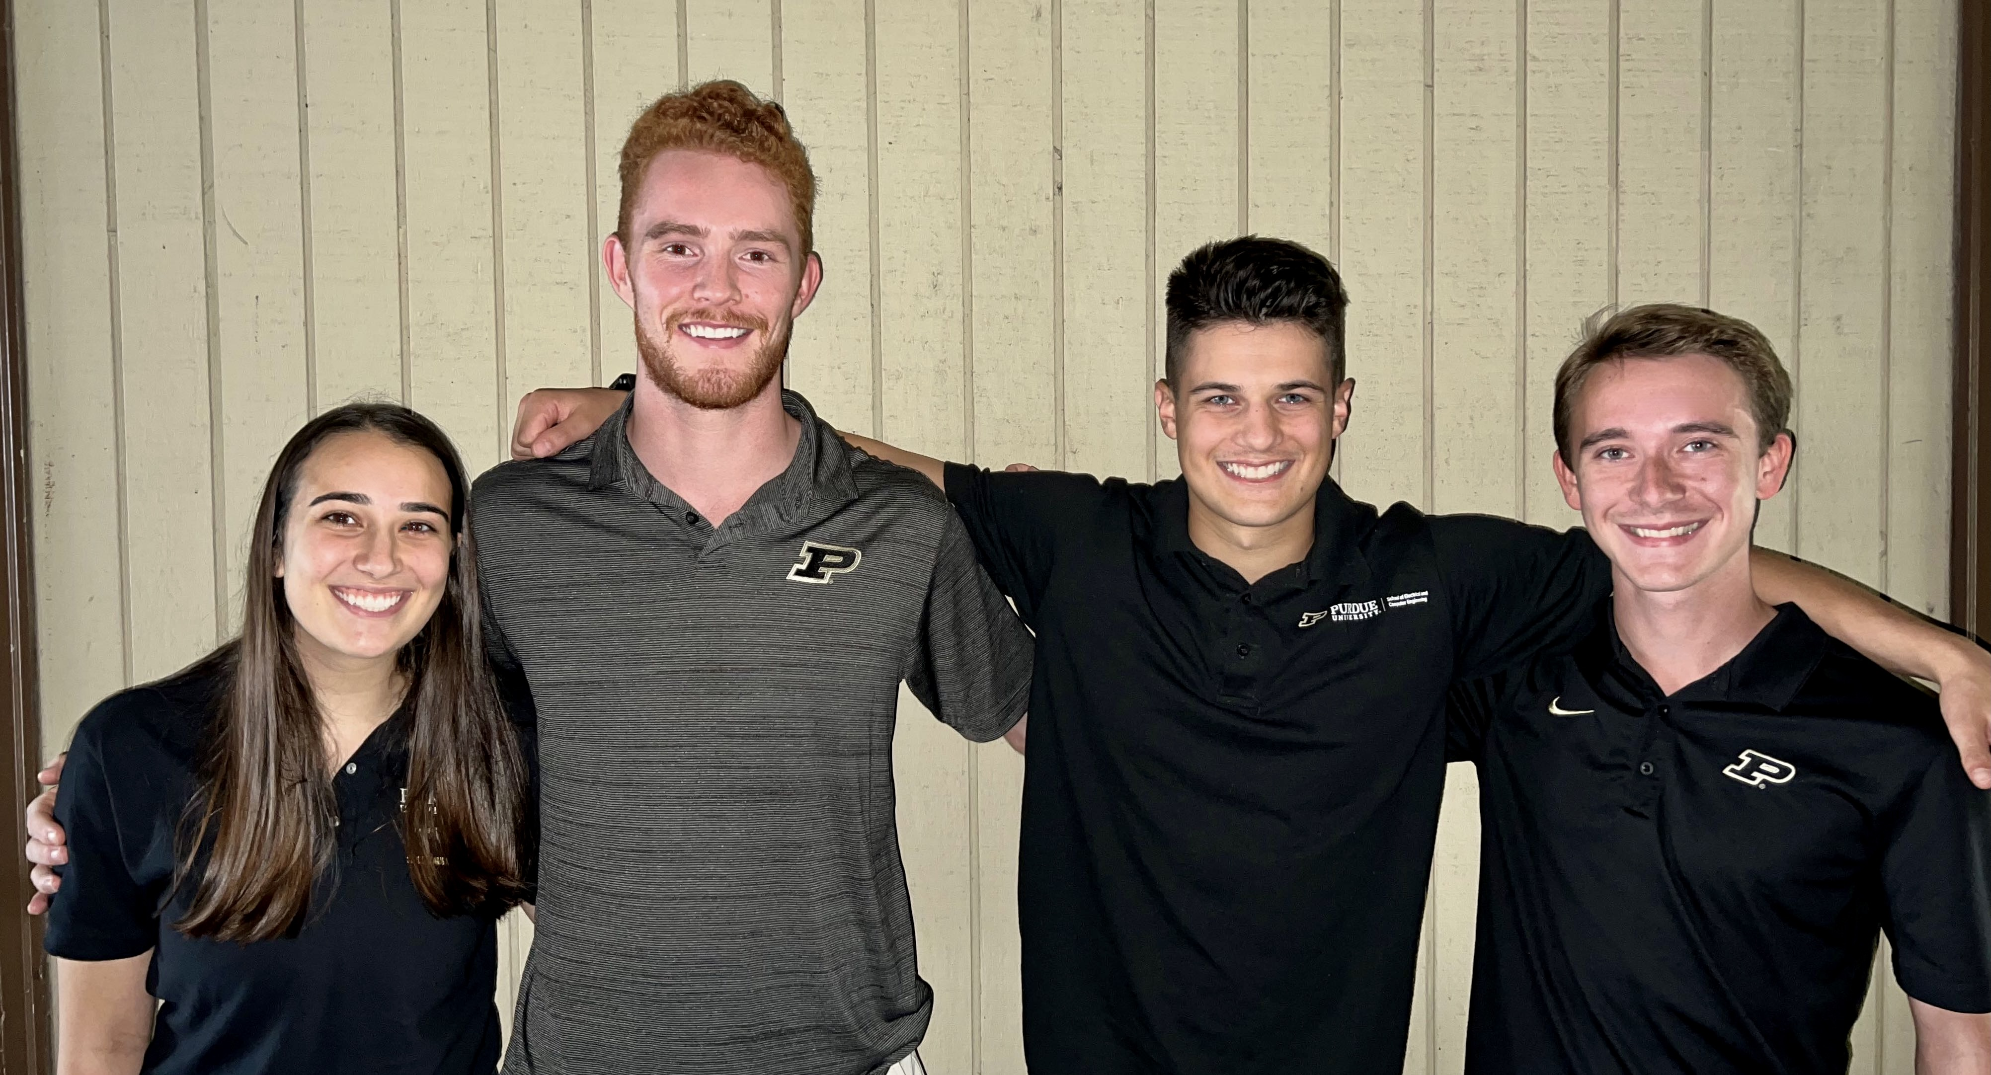


ECE477 Midterm Design Review: Team 8

Slide 2

Outline
Project Overview
Major Components
Block Diagram
Packaging Design
Electrical Schematic
PCB Layout
Prototyping Progress
Software Development Status
Project Timeline
Questions

Slide 3
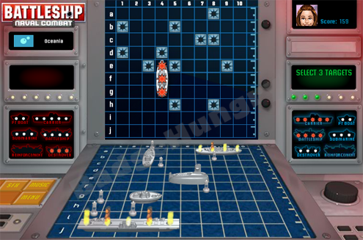
Project Overview
Sink or Be Sunk is a 21st century take on the classic Battleship game by Hasbro.
Allows users to play at a distance with Wi-Fi enabled boards that communicate with a server.
Incorporate tactile user input similar to the original game.
Includes audio, visual, and haptic feedback.

Slide 4
PSSCs
An ability to detect when a user positions their ship pieces on the game board.
An ability to provision a Wi-Fi connection through a Bluetooth BLE connection to a user’s smartphone.
An ability to light individual LEDs in a matrix in response to game events.
An ability to relay game move information between players over an internet connection.
An ability to provide physical feedback to a user with a rumble motor when a ship is sunk.

Slide 5
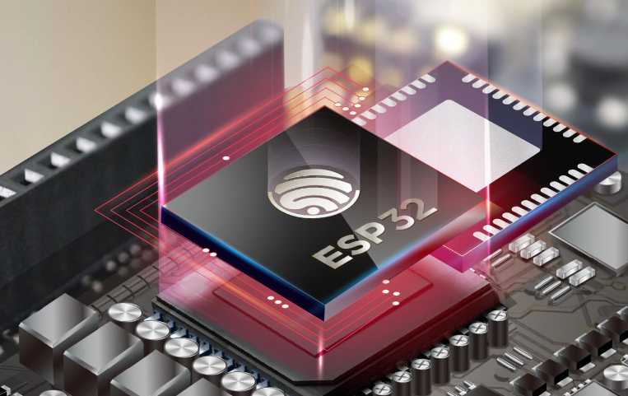
Major Components
Microcontroller
ESP32
Powerful Computational power
Has necessary peripherals (GPIO, DAC, SPI)
Can communicate on BLE and WIFI
Low-cost
MCU | Core | WIFI/BLE | DAC | GPIO | Price
ESP32 | Xtensa Dual-Core | Yes | 2 8-bit Channels | 34 | $8.95
ESP32-S2 | Xtensa Single-Core | Yes | 2 8-bit Channels | 43 | $10.73
ESP8266 | Tensilica L106 32-Bit | Yes | None | 17 | $6.95

Slide 6
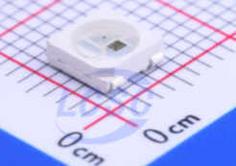
Major Components
LED
Worldsemi WS2812C
Individually soldered LEDs
Data-in to Data-out line
Automatically utilizes PWM
LED strips use these, but take more power and money
LED Type | Control | Power Consumption | Price per board
WS2812C | Daisy-Chained Shift register | 6 W | $12.8
LED Strips | Individually Addressable LEDs | ~15 - 45 W | $20 - $30

Slide 7
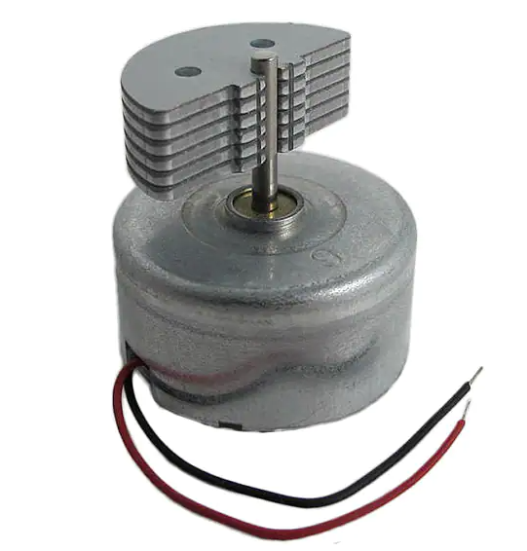
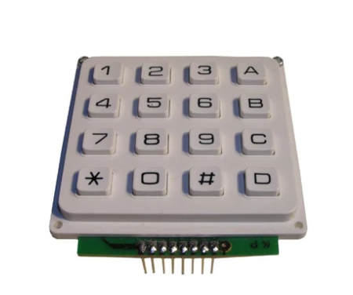
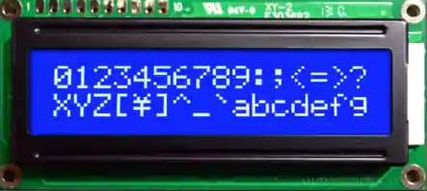
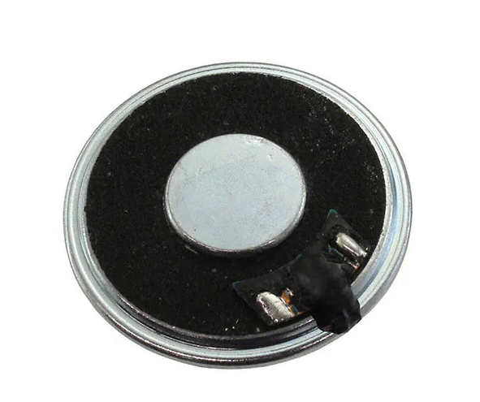
Major Components
Motor, Keypad, LCD, Speaker
Motor – Jinlong JQ24-35F580C - $5.46
DC Vibration Motor for response to game events
Keypad – Technological Arts 4x4 Matrix Keypad - $8.00
Utilized from ECE362 for User Coordinate input
Through Hole Mount
LCD – Orient Display AMC1602AR-B - $12.69
16x2 Blue LCD character Display Module
SPI communication for User Experience
Speaker – Soberton SP-4005Y - $1.85
General Purpose 400 Hz – 5 Khz Speaker
Plays sounds in response to game events

Slide 8
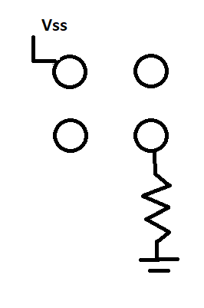
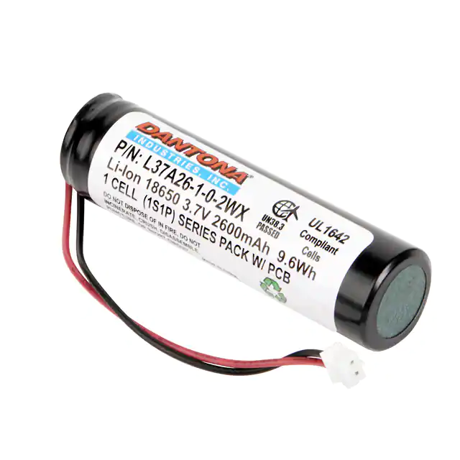
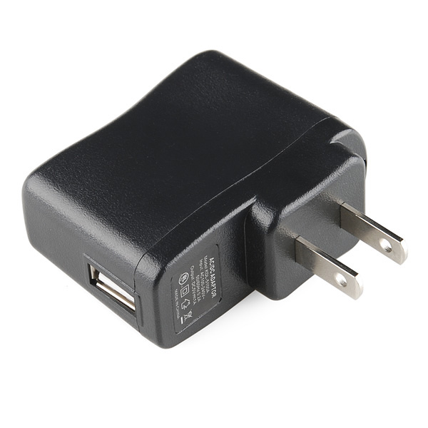
Major Components
Boat detection & Power
Boat Detection
Boats have a 4-pin male connector on tip and tail of boat
Plugs into a 4-pin female connector that creates a High voltage level
Software detects boat information on length
Power
5 Volt USB Charging brick
Switching Regulator
Backup LiPo Battery
Notes:
power other options:
AC to DC on board
most industry product don’t do this as it makes for a more bulky package
9V barrel jack
This wouldn’t allow for USB programming, need an additional usb port

Slide 9
BAttery POwer Calculations
description | voltage (V) | current (mA) | quantity | power (watt)
ESP32 | 3.3 | 750 | 1 | 2.475
LED RGB | 3.3 | 15 | 128 | 6.336
LCD Screen | 3.3 | 250 | 1 | 0.825
Speaker | 0 | 0 | 1 | 1.000
Resistive Ships | 3.3 | 0.00033 | 10 | 0.000
 |  | 1015.00033 | Total | 10.636
 |  | 790.712 | Total RSS | 6.925
Battery (Min) | 3.7 | 2600 | 1 | 9.62
 |  | hrs-> | Play Time (Min) | 0.90
 |  |  | Play Time (Typ) | 1.39

Slide 10


Block Diagram
Charger
Backup
Battery
Game Server
2
2
DCDC Converter
LCD
USB
2
SPI
(no MISO)
3
User
Device
2
USB to UART
2
4
Microcontroller
ESP32
1
Rumble Motor
Legend
Button Matrix
4x4
8
1
3.3 Volts
5 Volts
Speaker
3
DAC
1
1
Ship Slot 0
8
8x1
Mux0
3
8
LED Daisy Chain 1
…
…
8x1
Mux
…
Ship Slot 63
8
8x1
Mux7
LED Daisy Chain 128

Slide 11
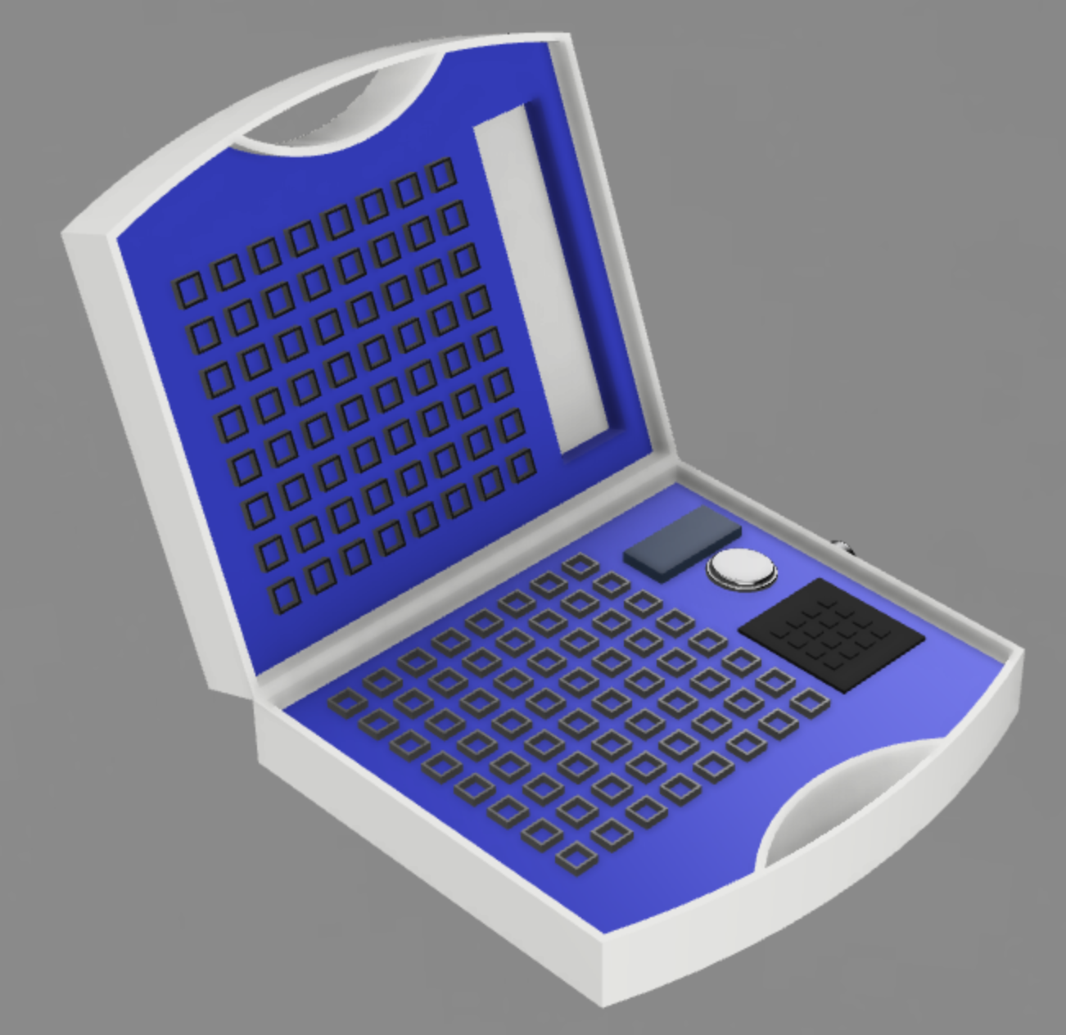
Packaging Design
External Dimensions
33.5cm x 27.0cm x 8.0 cm
Internal Dimensions
32.7cm x 20.5cm x 3.9cm

Slide 12
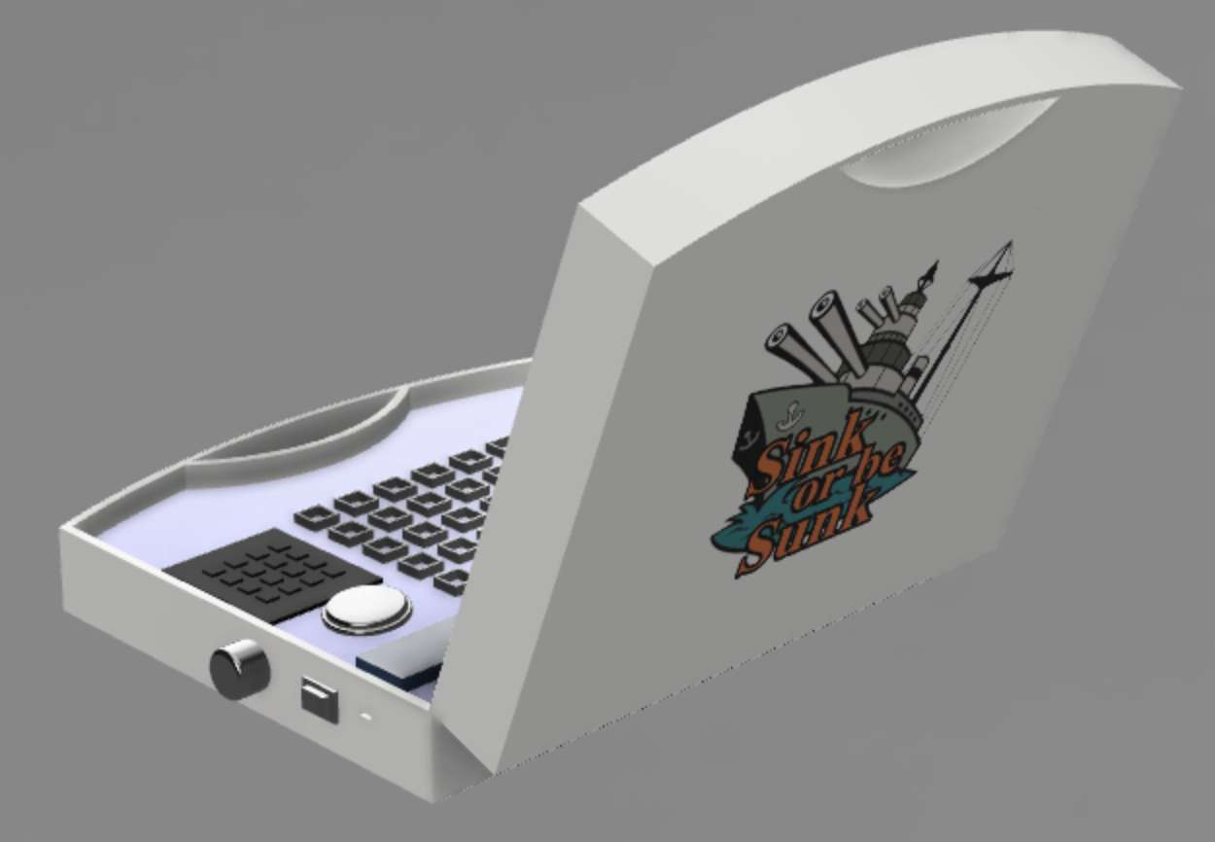
Packaging Design

Slide 13
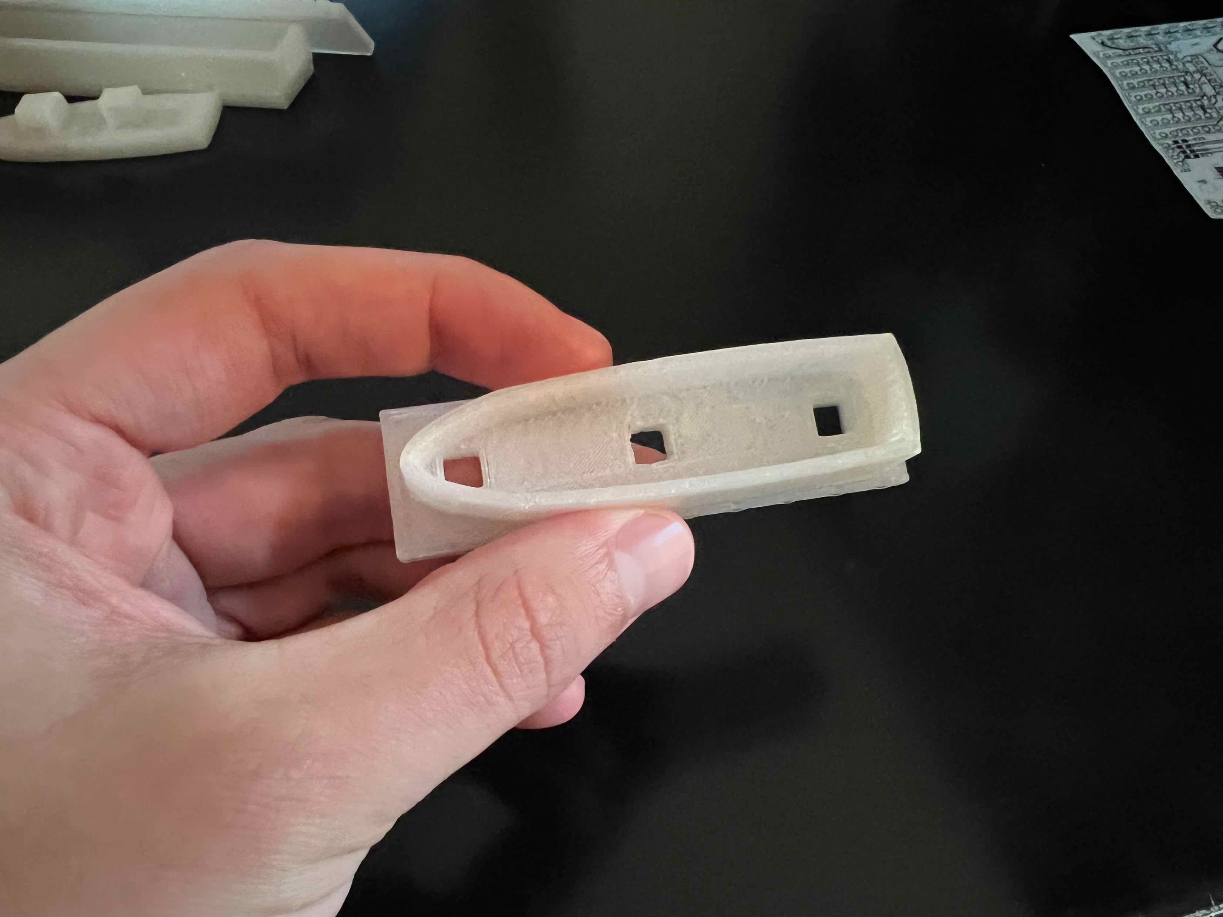
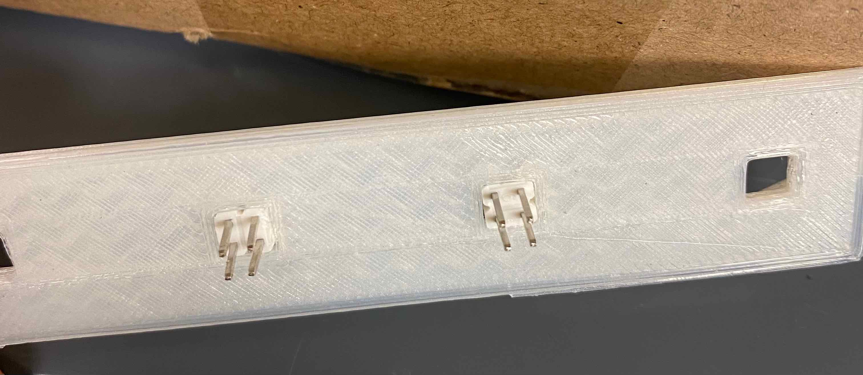
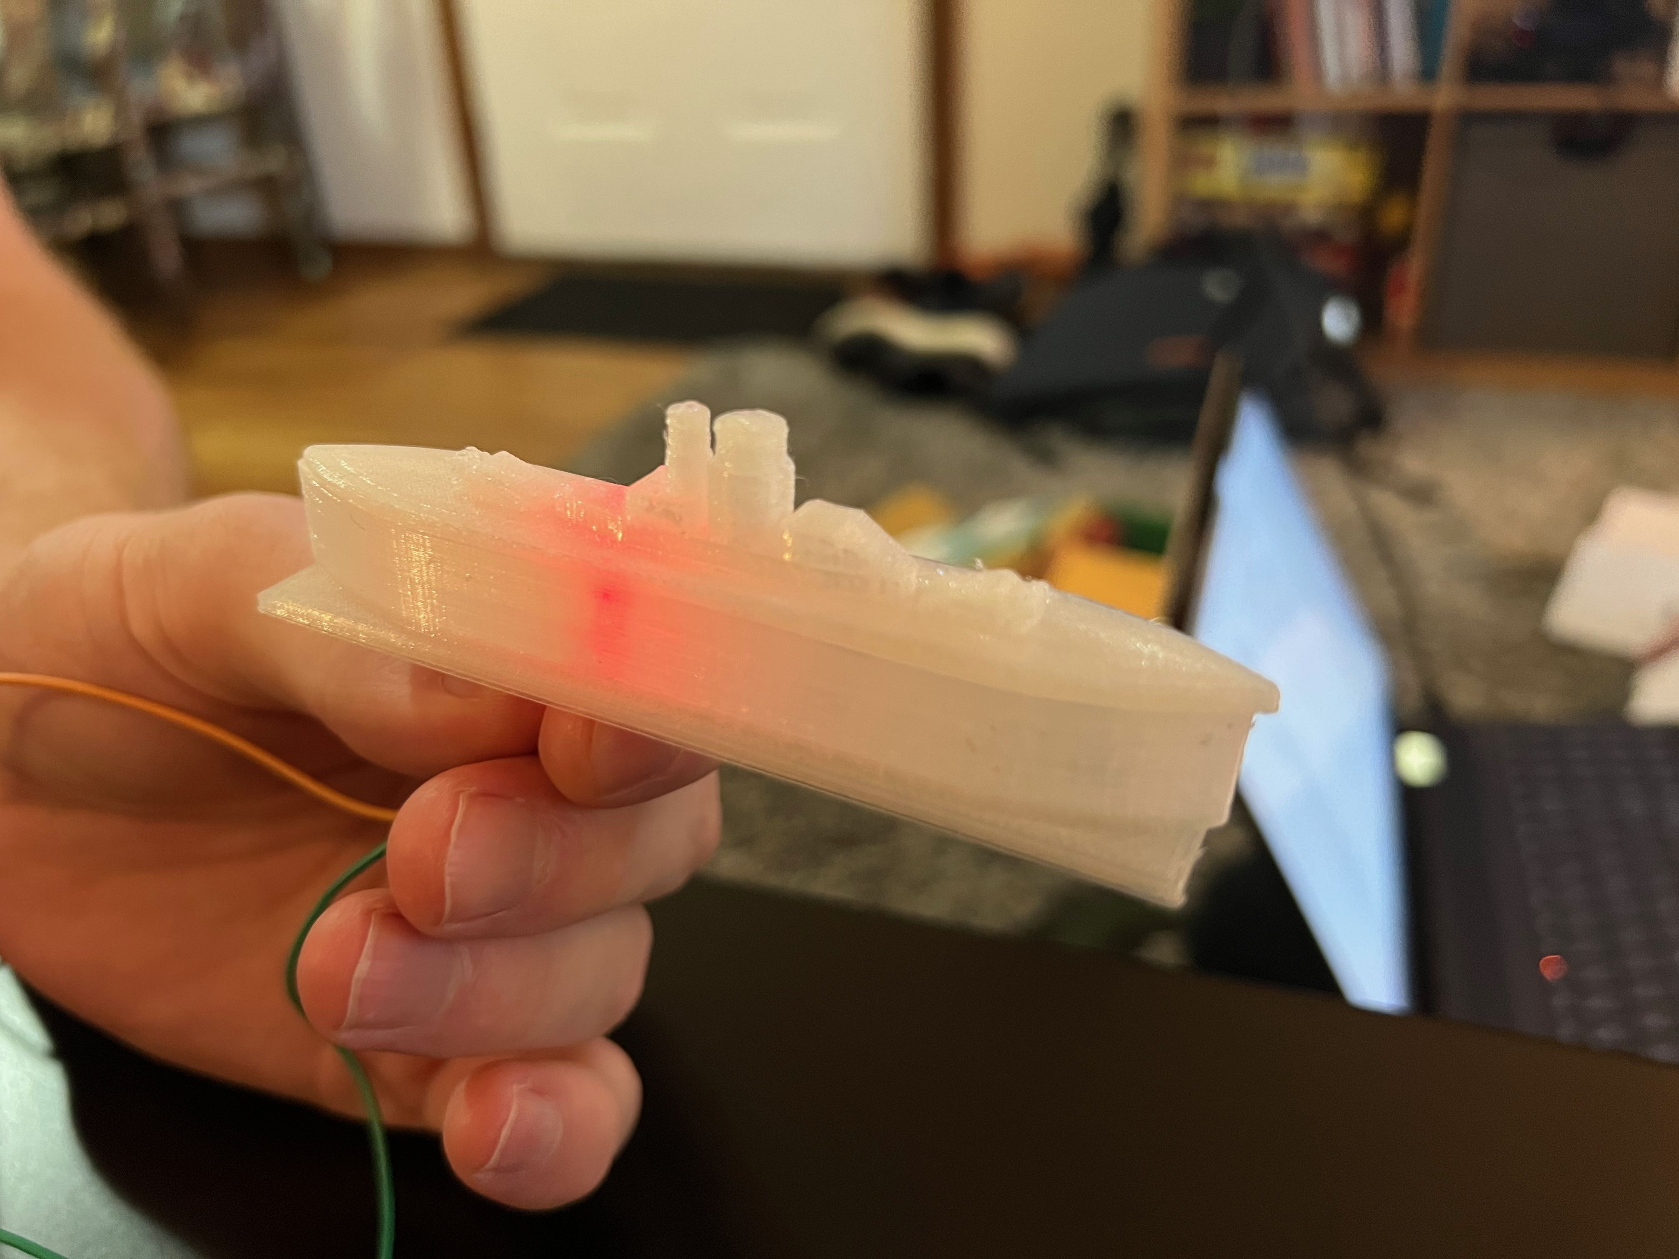
Packaging Design
Boat Design

Slide 14
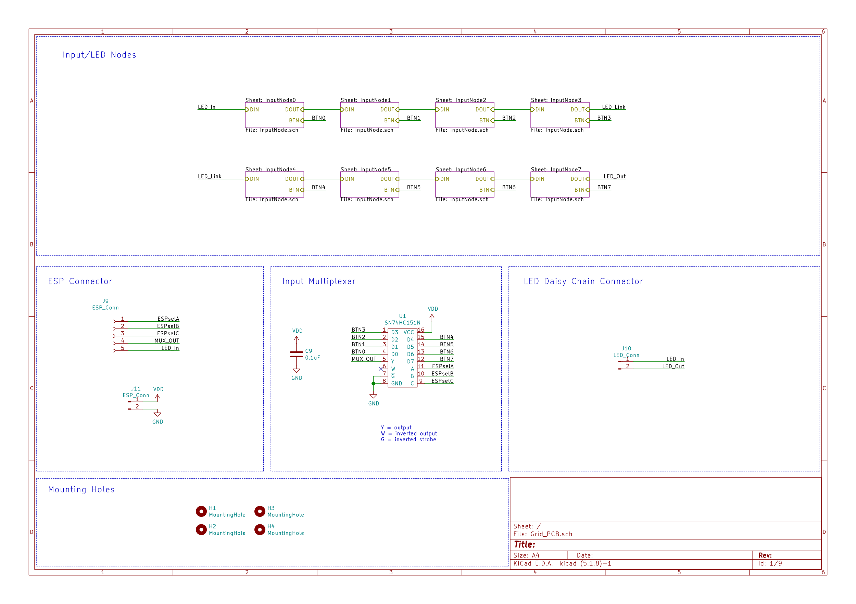
Electrical Schematic – Grid pcb
Overview

Slide 15

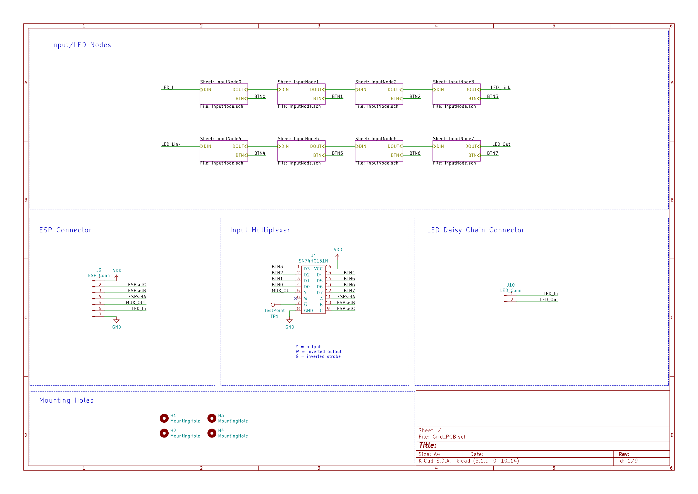
Electrical Schematic – Grid pcb
Connectors

Slide 16
Electrical Schematic – Grid pcb
input selection mux

Slide 17
Electrical Schematic – Grid pcb
Input/LED Nodes

Slide 18
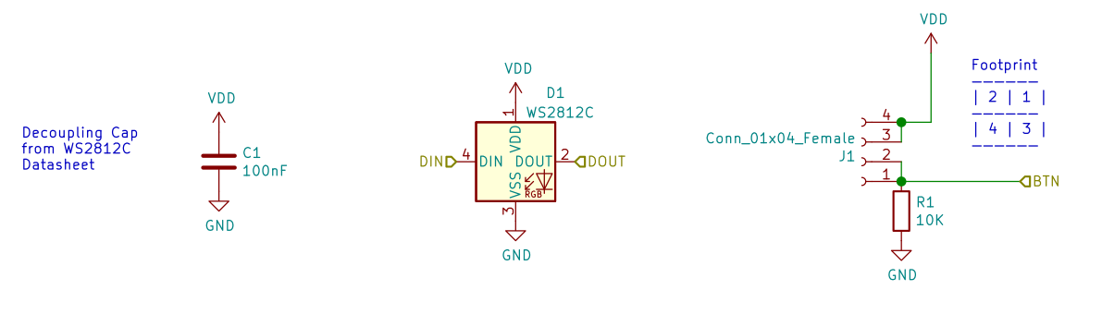
Electrical Schematic – Grid pcb
LED/Input node

Slide 19
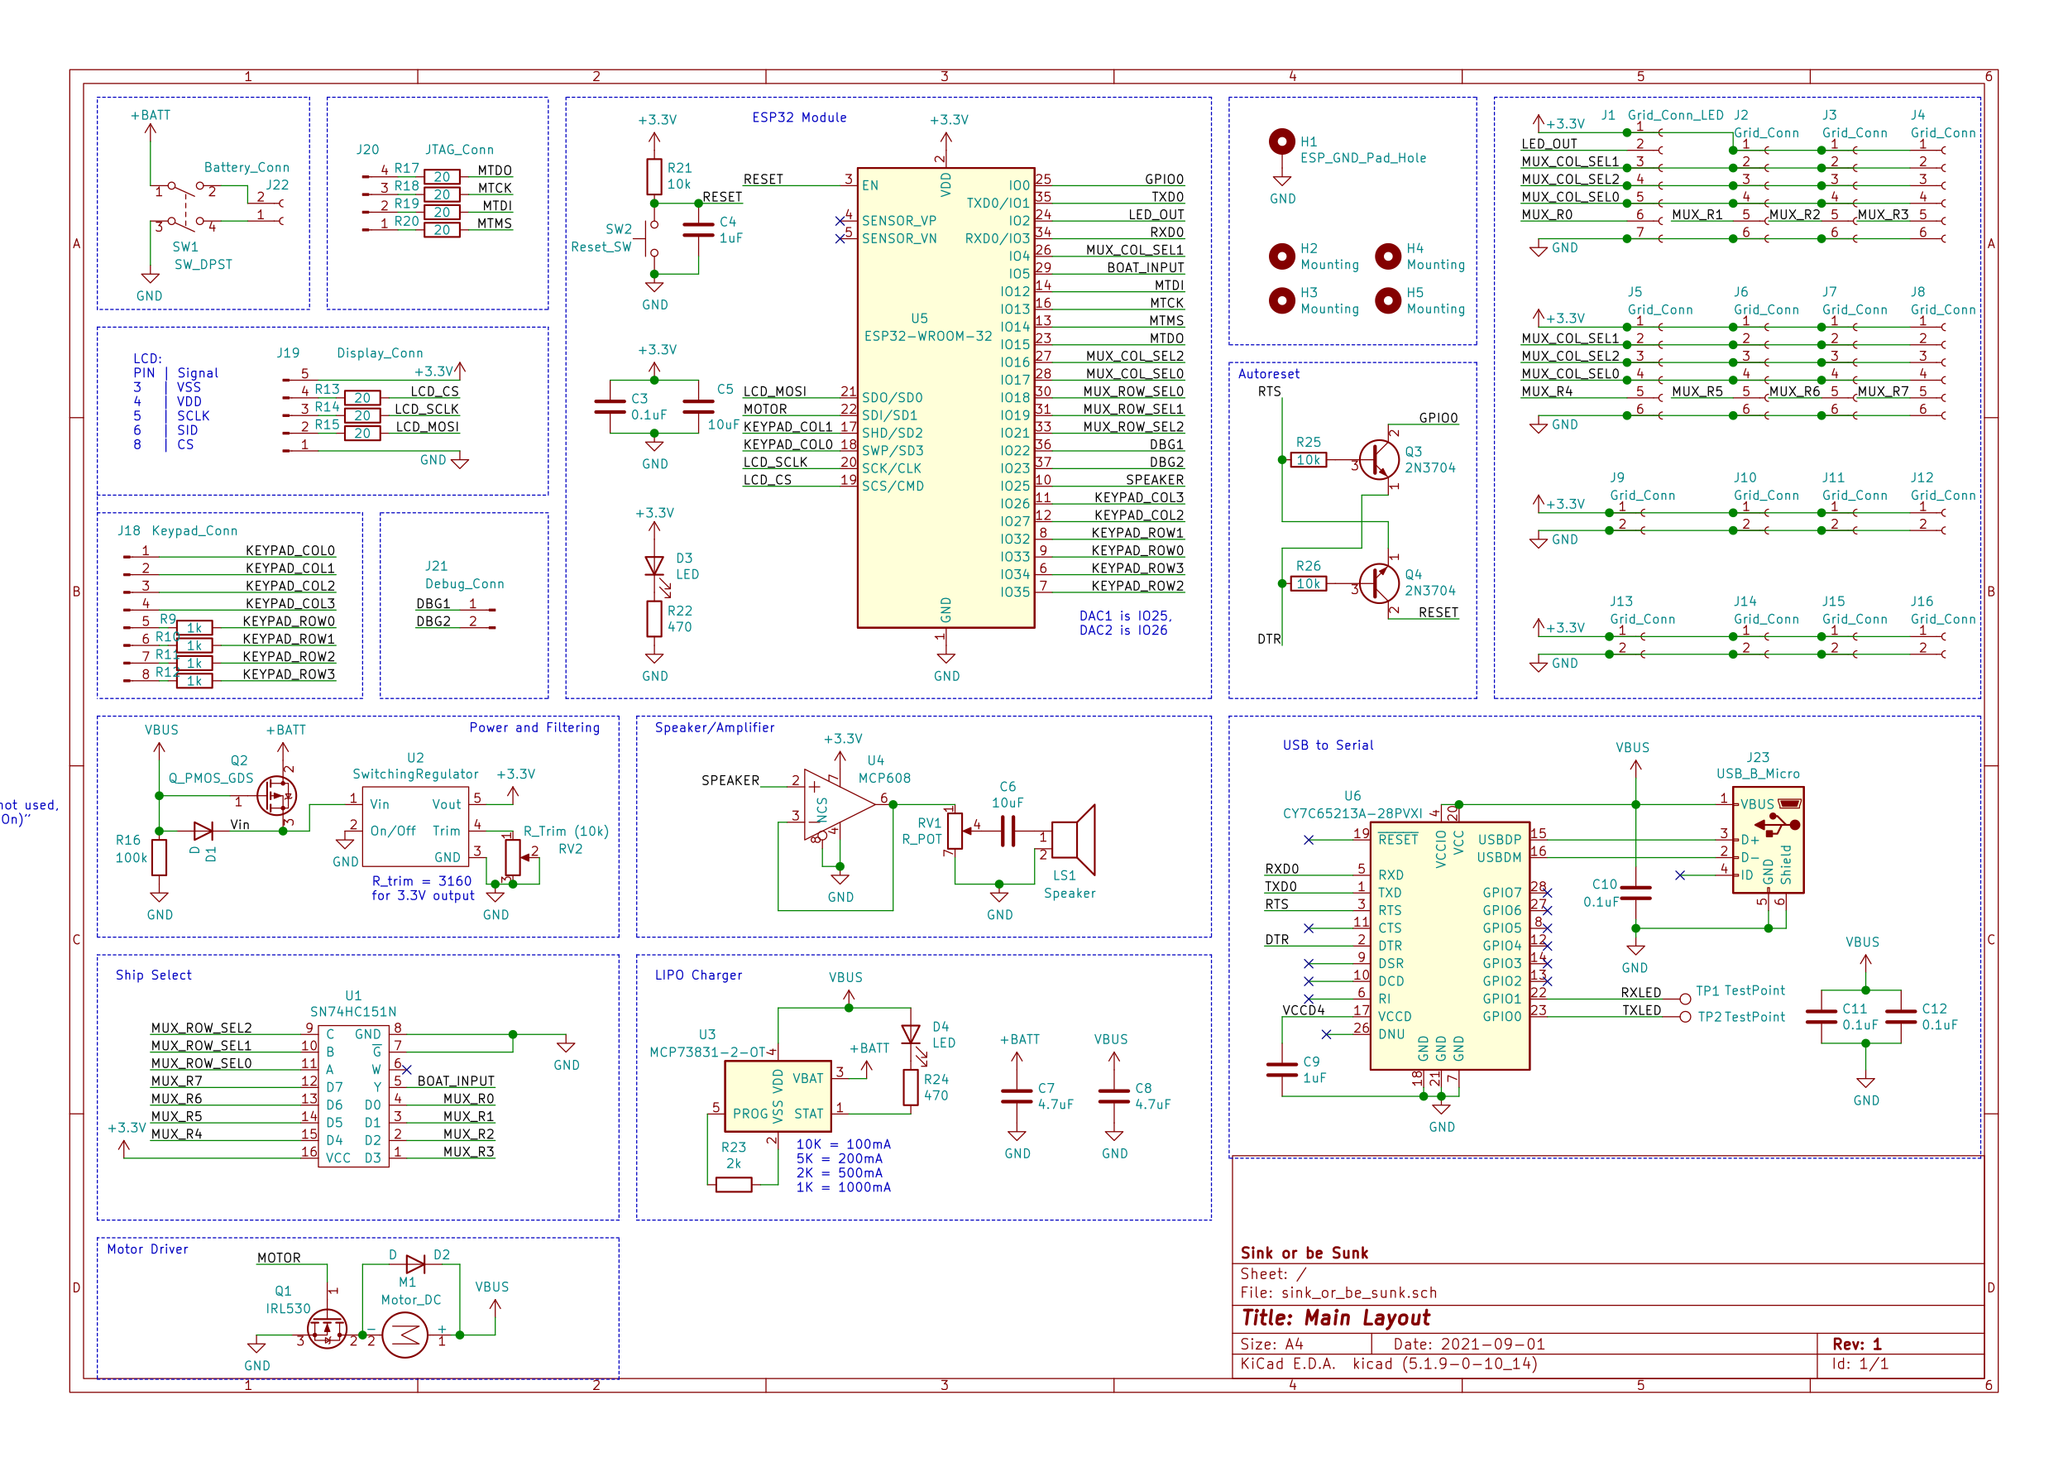
Electrical Schematic – ESP pcb
Overview

Slide 20
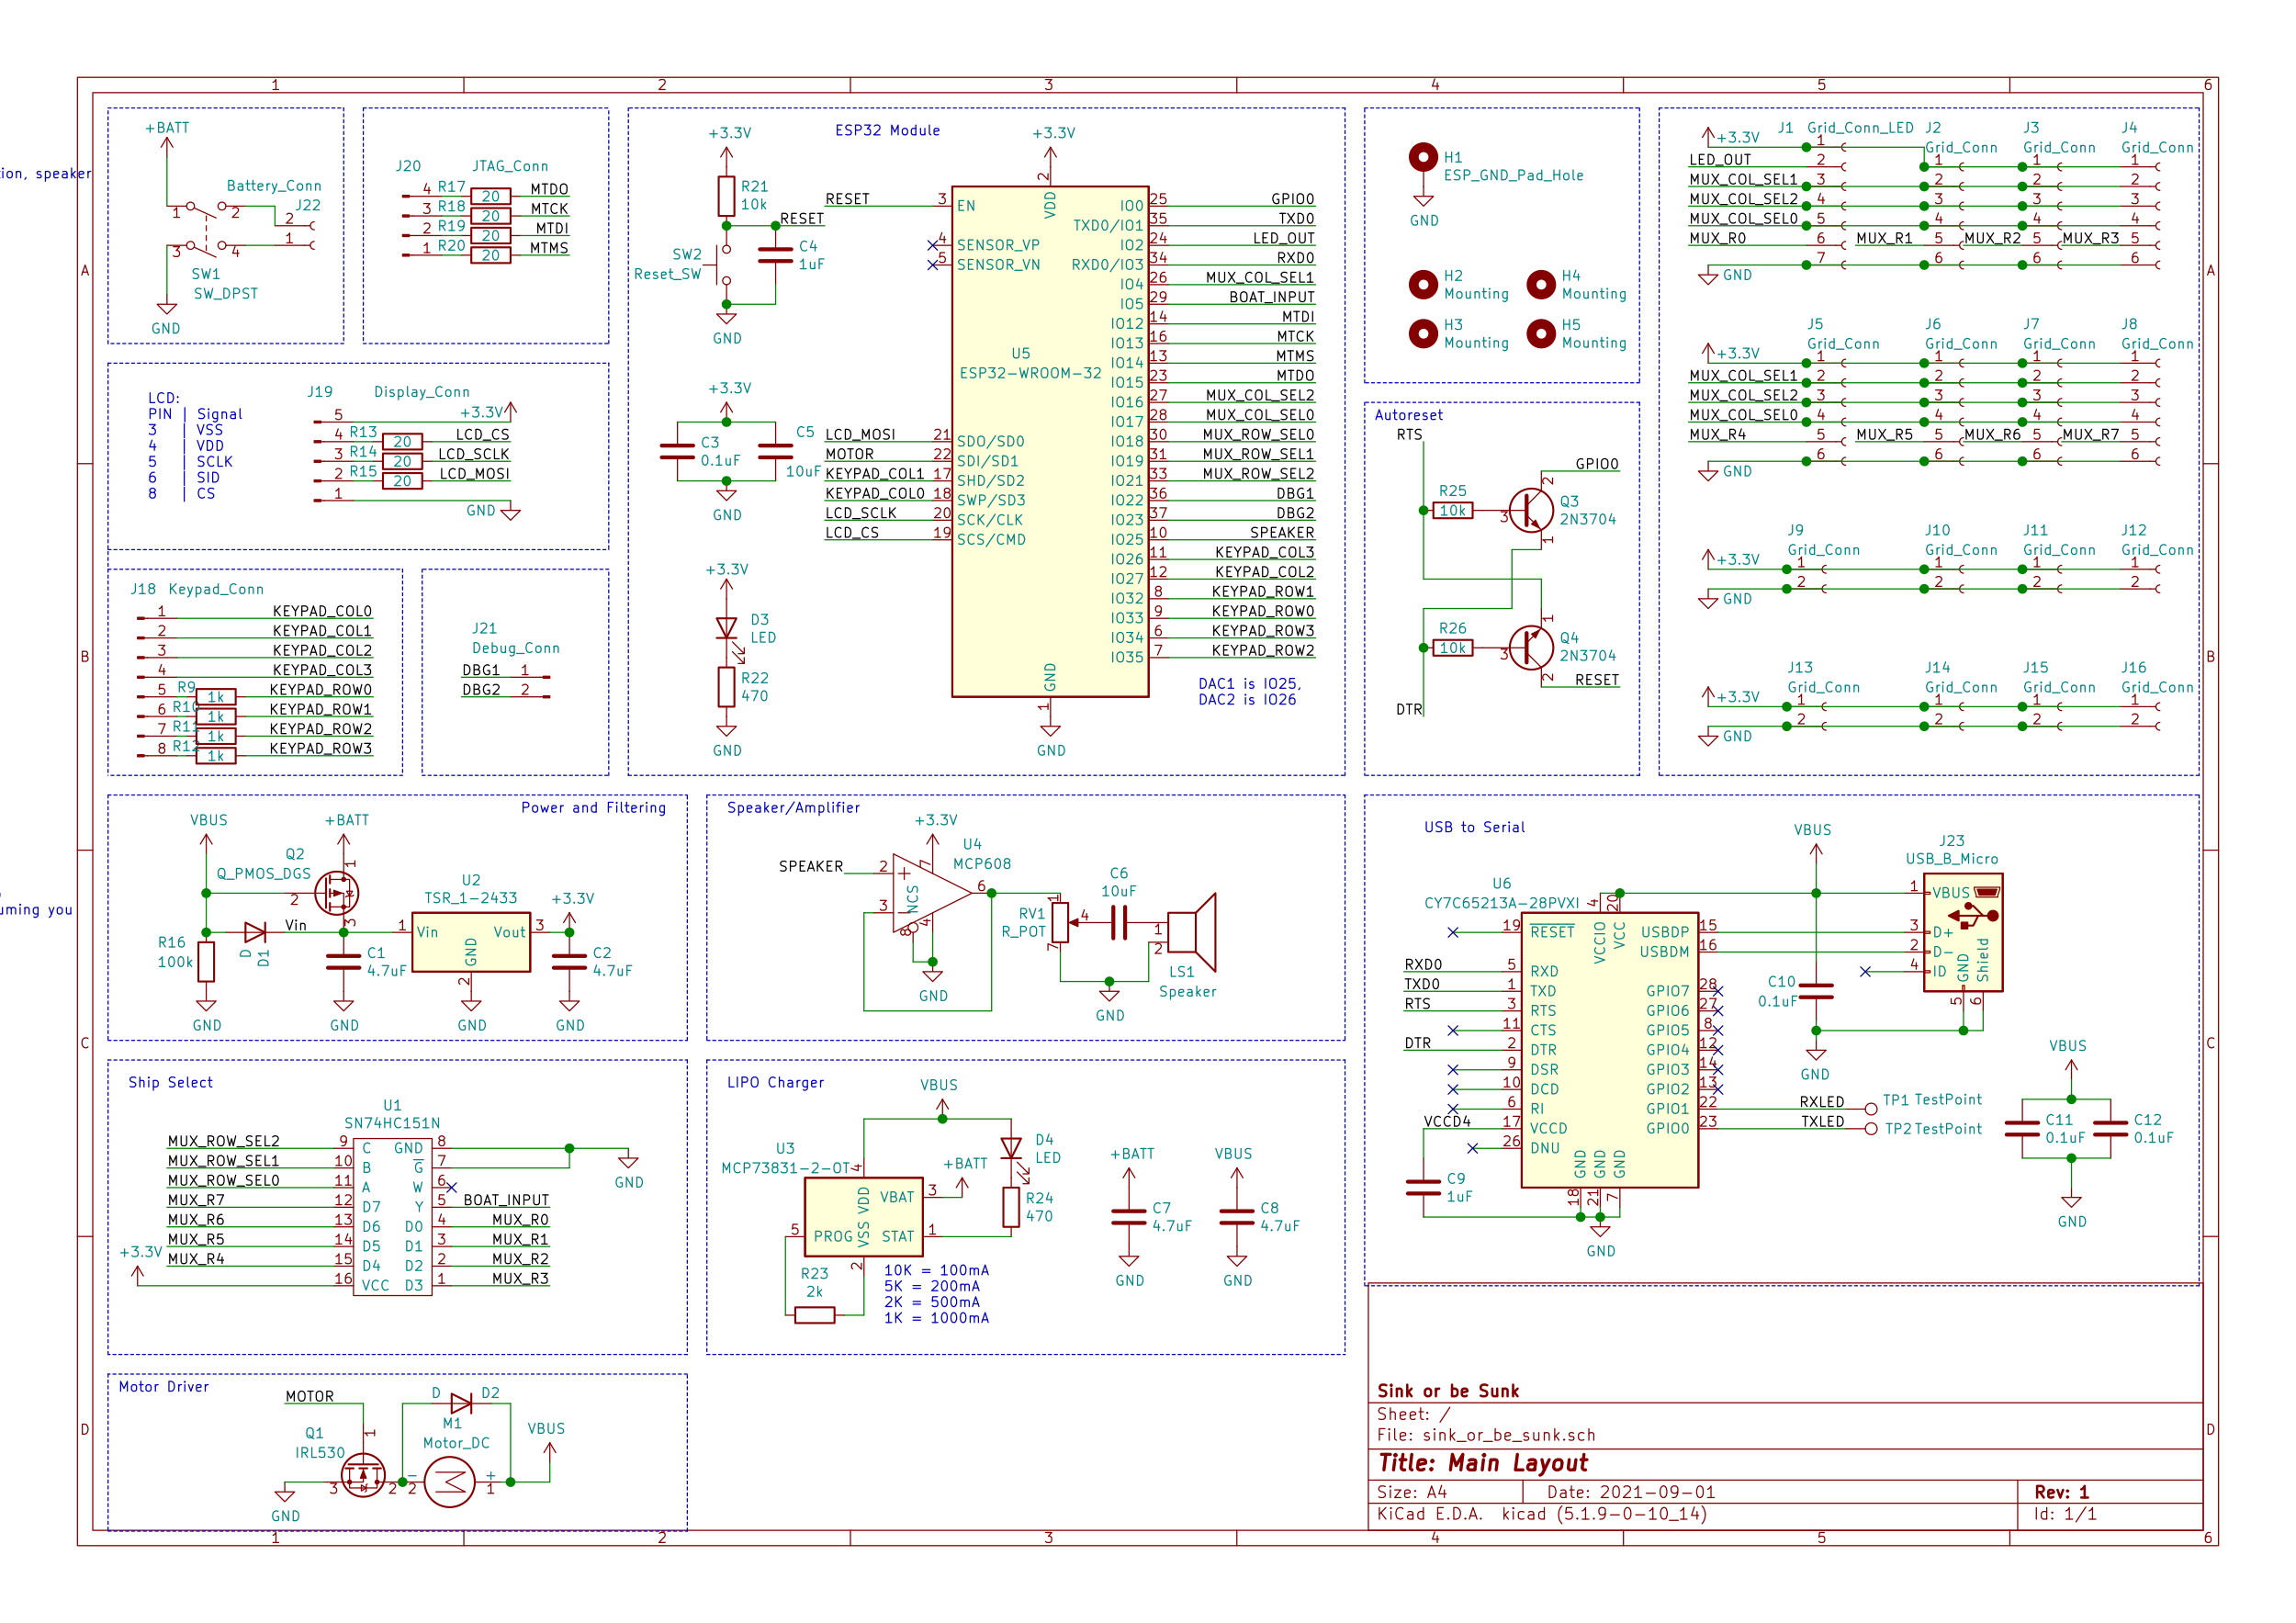
Electrical Schematic – ESP pcb
ESP-grid pcb interconnects

Slide 21
Electrical Schematic – ESP pcb
ESP-grid cabling

Slide 22
Electrical Schematic – ESP pcb
peripheral connectors

Slide 23
Electrical Schematic – ESP pcb
Battery isolation switch

Slide 24
Electrical Schematic – ESP pcb
Esp 32

Slide 25
Electrical Schematic – ESP pcb
Motor

Slide 26
Electrical Schematic – ESP pcb
Speaker

Slide 27
Electrical Schematic – ESP pcb
Input multiplexer

Slide 28
Electrical Schematic – ESP pcb
power regulation

Slide 29
Electrical Schematic – ESP pcb
Battery charger

Slide 30
Electrical Schematic – ESP pcb
Serial programmer

Slide 31
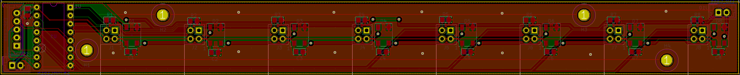
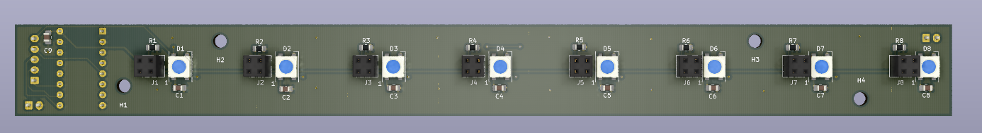
PCB Layout – Grid PCB
Overview
Dimensions
85.555mm x 79.616mm
3.368in x 3.134in
Features
Input Selection Mux
Boat Input and LED Nodes
Connectors

Slide 32
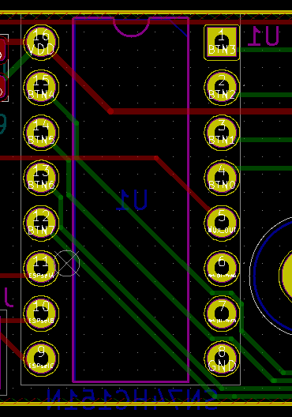
PCB Layout – Grid PCB
Input Selection Mux

Slide 33
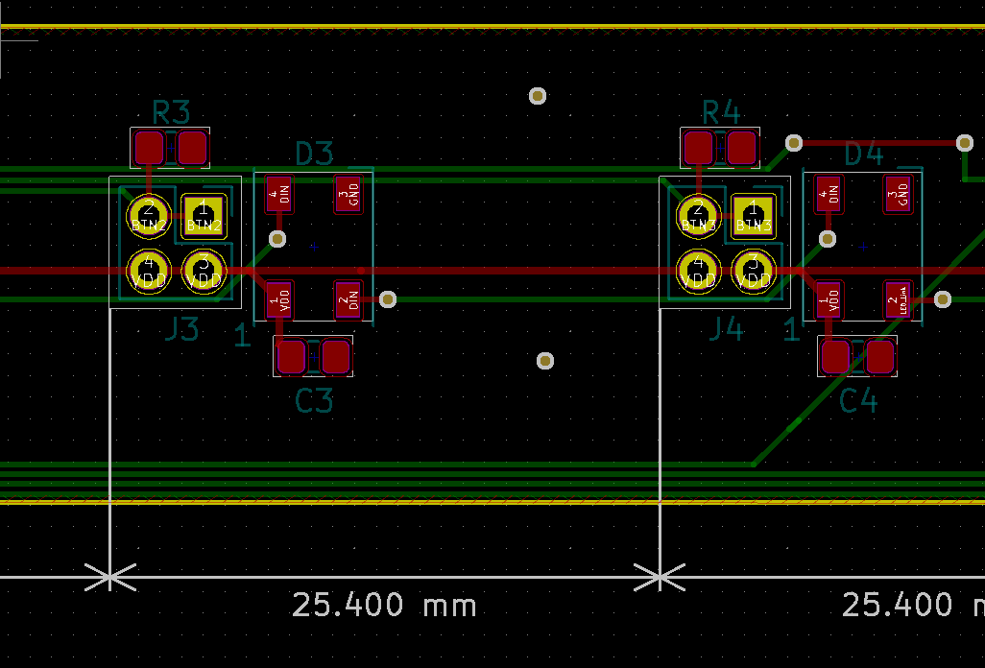
PCB Layout – Grid PCB
Boat Input and LED Nodes

Slide 34
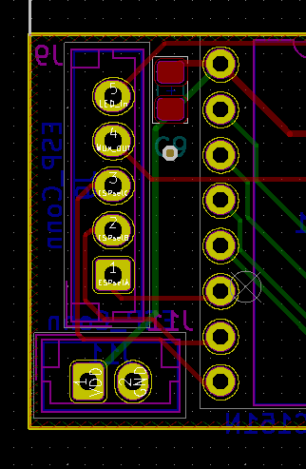
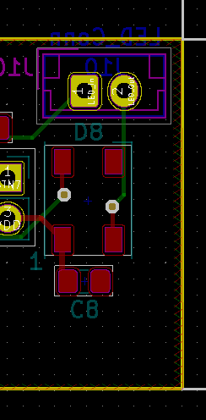
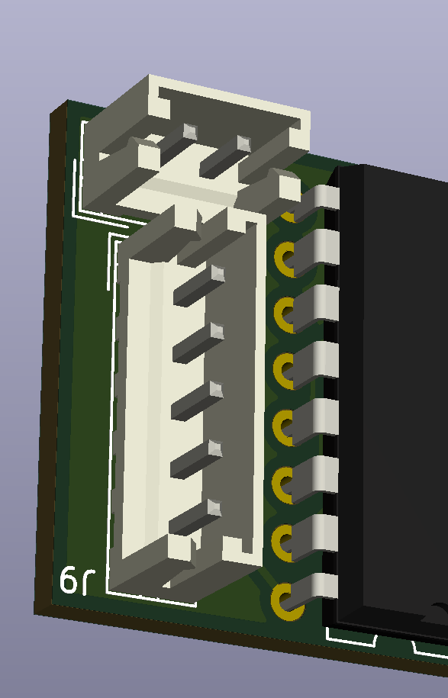
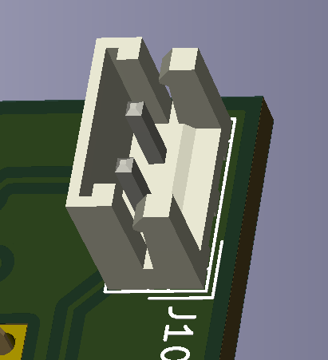
PCB Layout – Grid PCB
Connectors

Slide 35
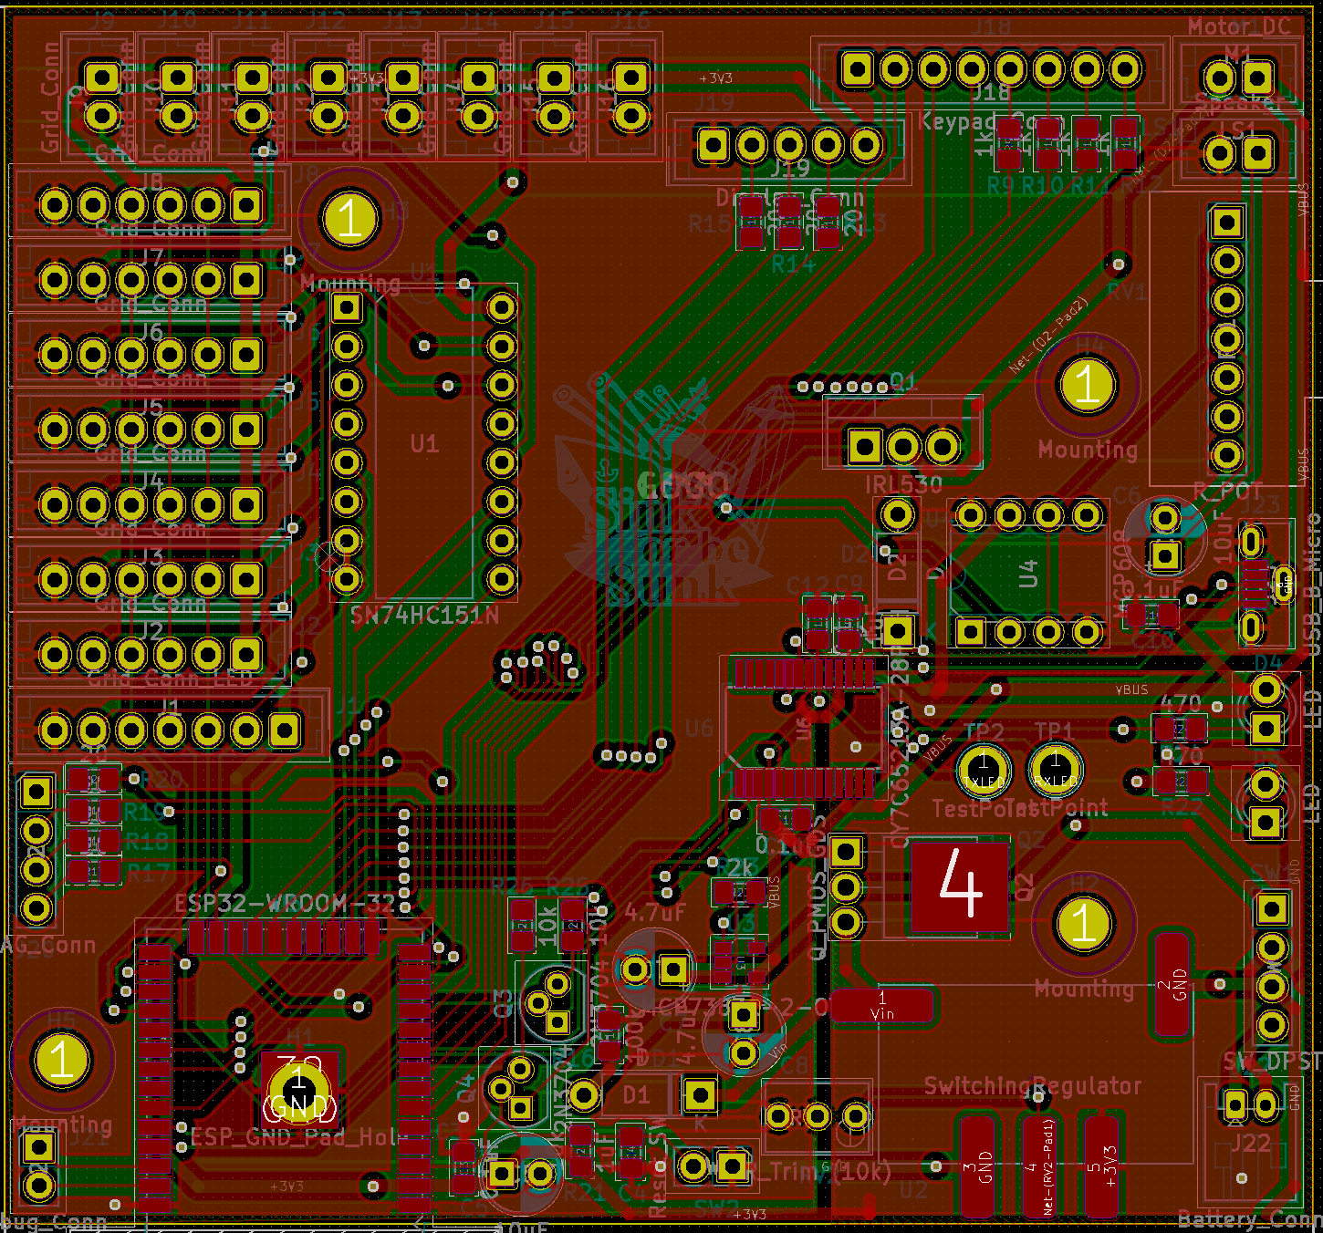
PCB Layout – ESP PCB
Overview
Dimensions
85.555mm x 79.616mm
3.368in x 3.134in
Features
ESP32
ESP32 to Grid Connectors
Peripheral Connectors
Motor
Speaker
Input Multiplexer
Power Regulation
Battery Charger
Battery Isolation Switch
Serial Programmer

Slide 36
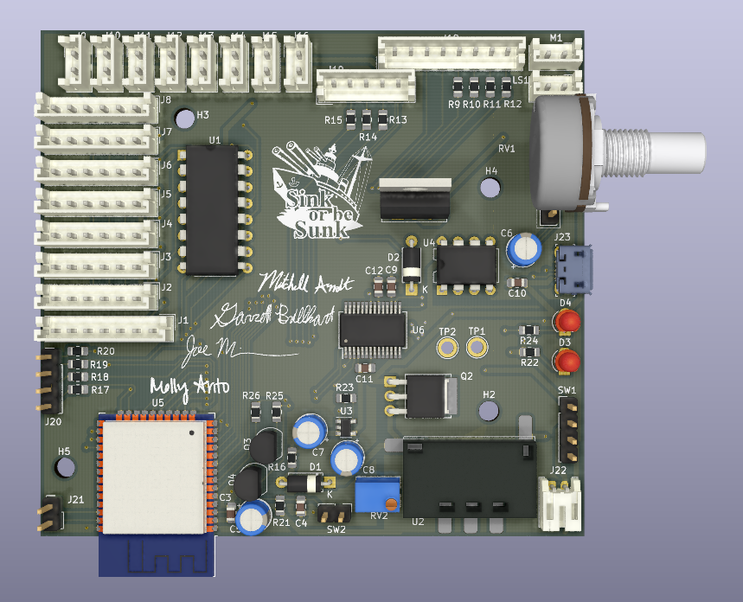
PCB Layout – ESP PCB
Overview - Render
Dimensions
85.555mm x 79.616mm
3.368in x 3.134in
Features
ESP32
ESP32 to Grid Connectors
Peripheral Connectors
Motor
Speaker
Input Multiplexer
Power Regulation
Battery Charger
Battery Isolation Switch
Serial Programmer

Slide 37
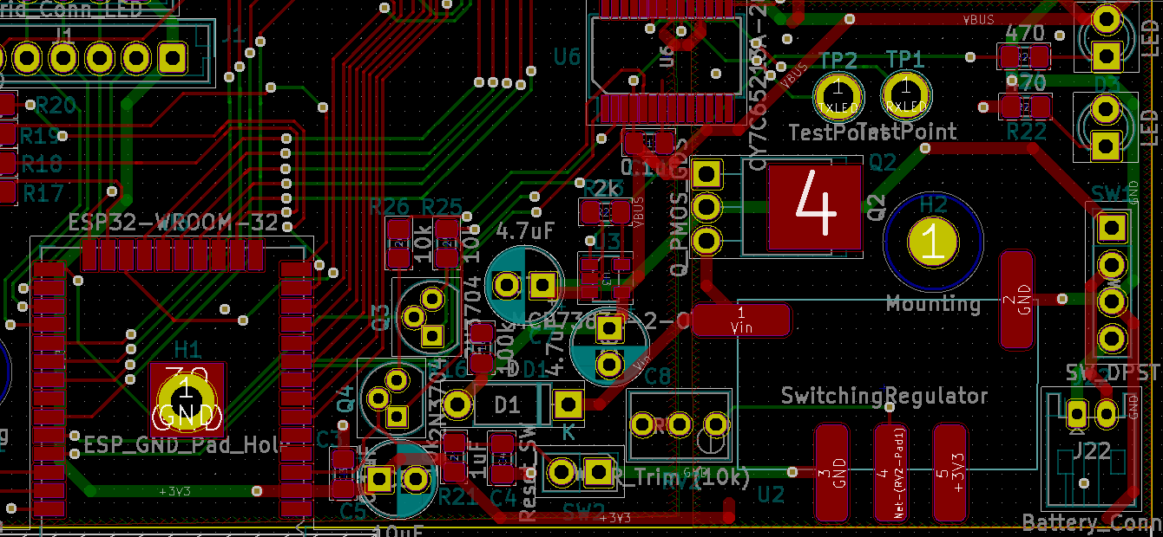
PCB Layout – ESP PCB
ESP32

Slide 38
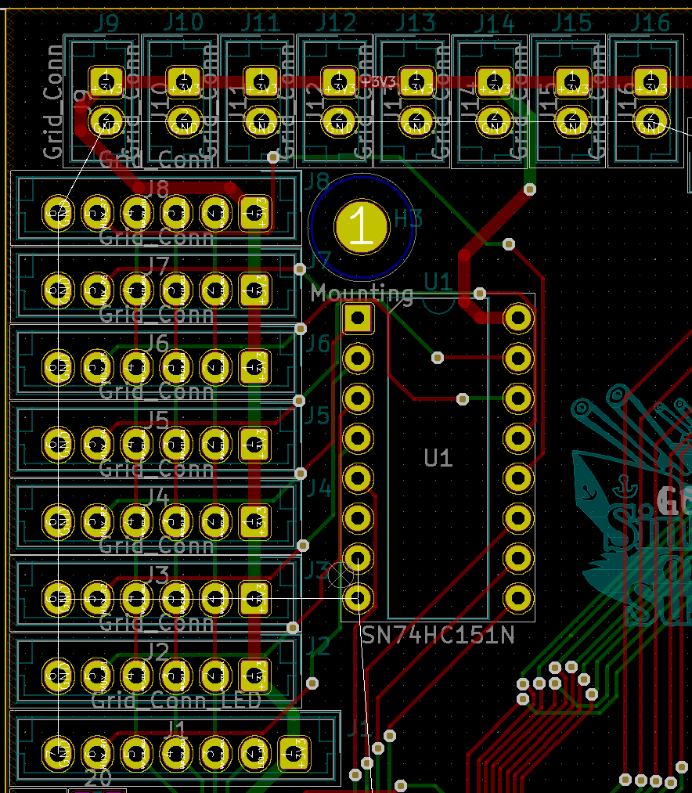
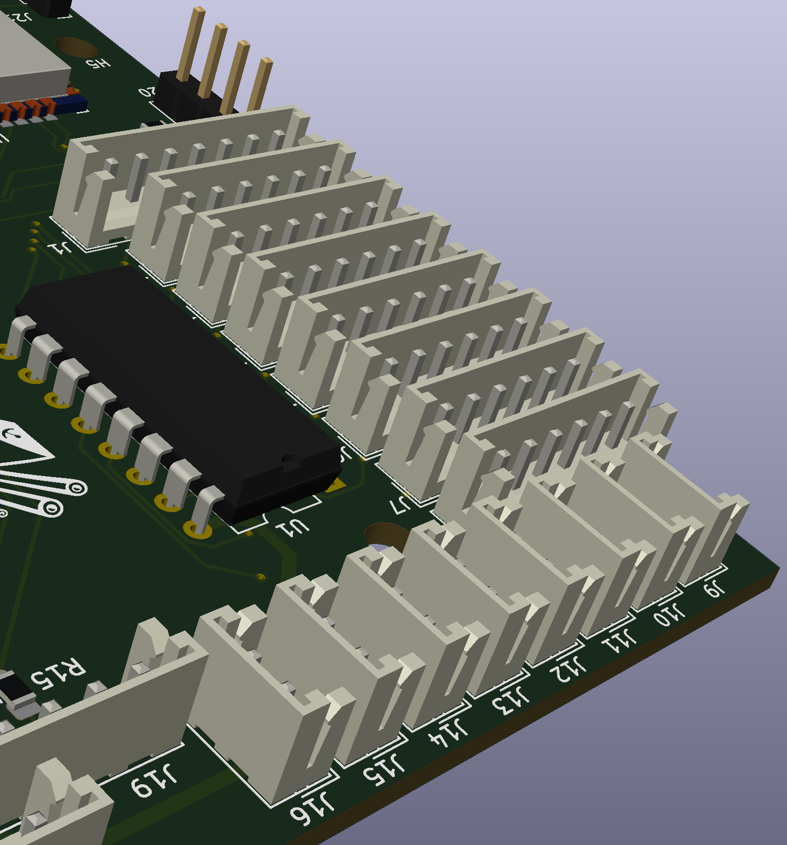
PCB Layout – ESP PCB
ESP TO GRID INTERCONNECTS

Slide 39
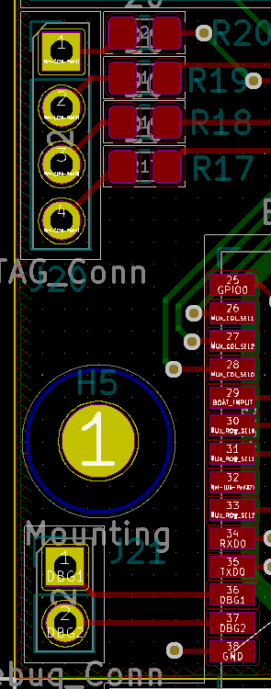
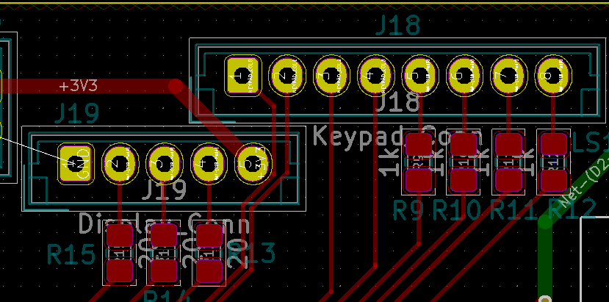
PCB Layout – ESP PCB
PERIPHERAL CONNECTORS

Slide 40
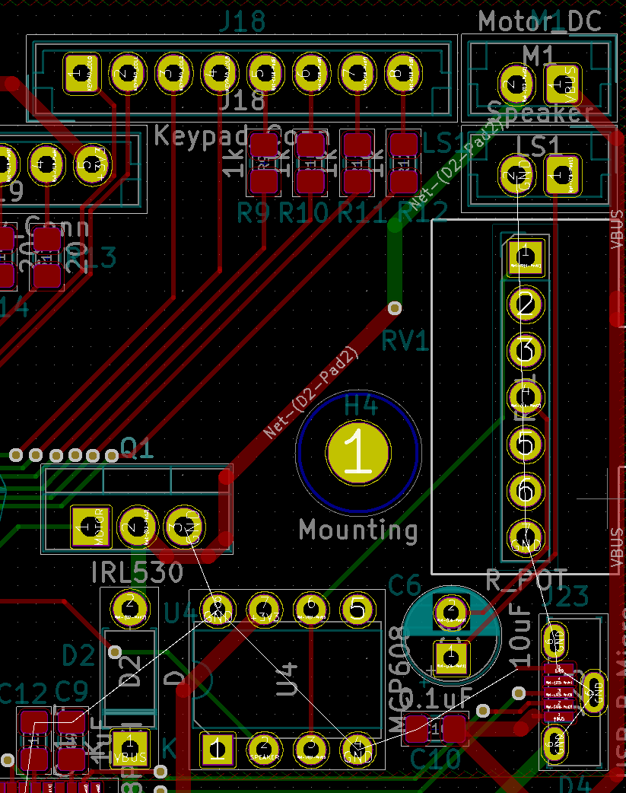
PCB Layout – ESP PCB
MOTOR

Slide 41
PCB Layout – ESP PCB
SPEAKER

Slide 42
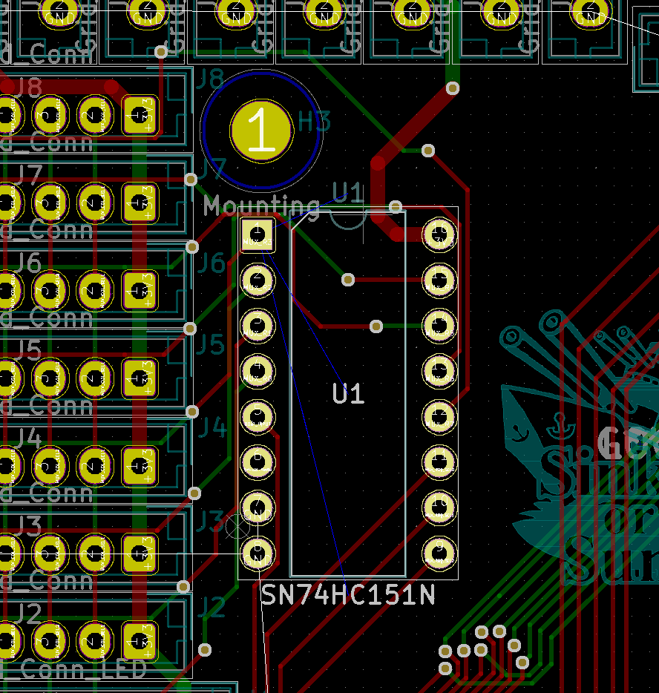
PCB Layout – ESP PCB
INPUT MULTIPLEXER

Slide 43
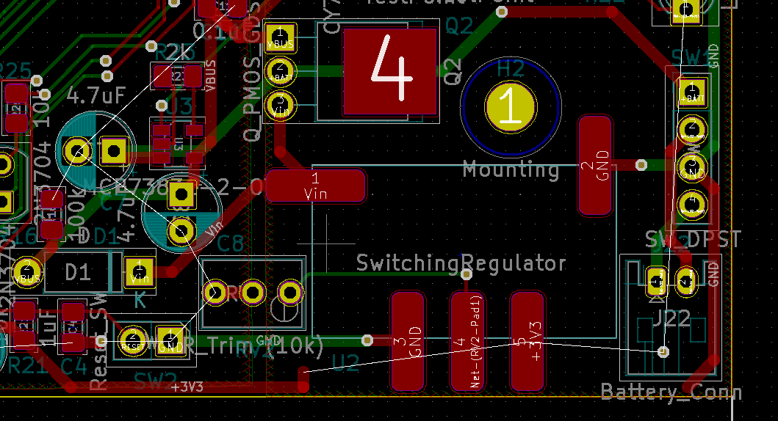
PCB Layout – ESP PCB
POWER REGULATION

Slide 44
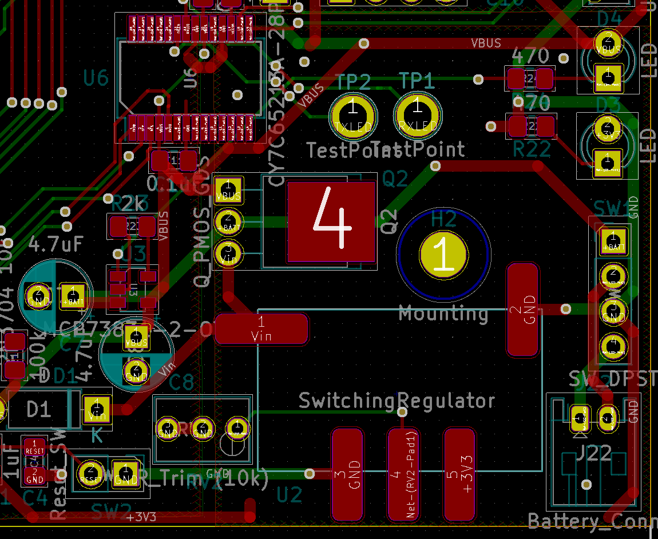
PCB Layout – ESP PCB
BATTERY CHARGER

Slide 45
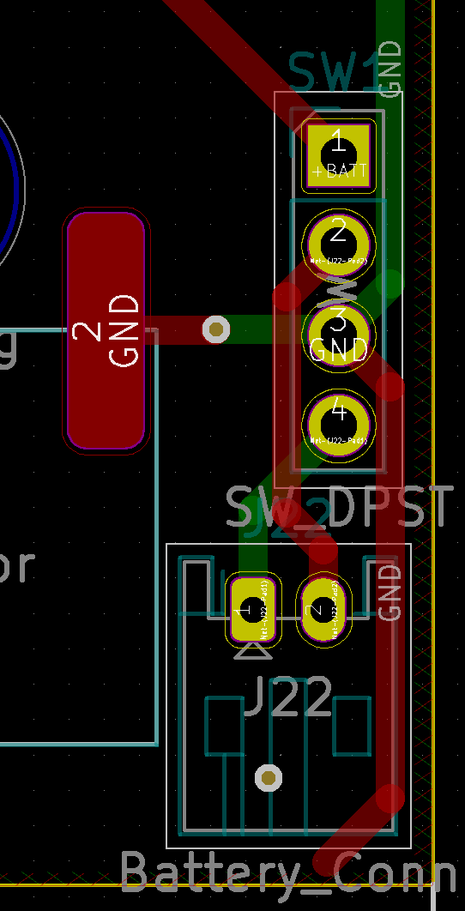
PCB Layout – ESP PCB
BATTERY ISOLATION SWITCH

Slide 46
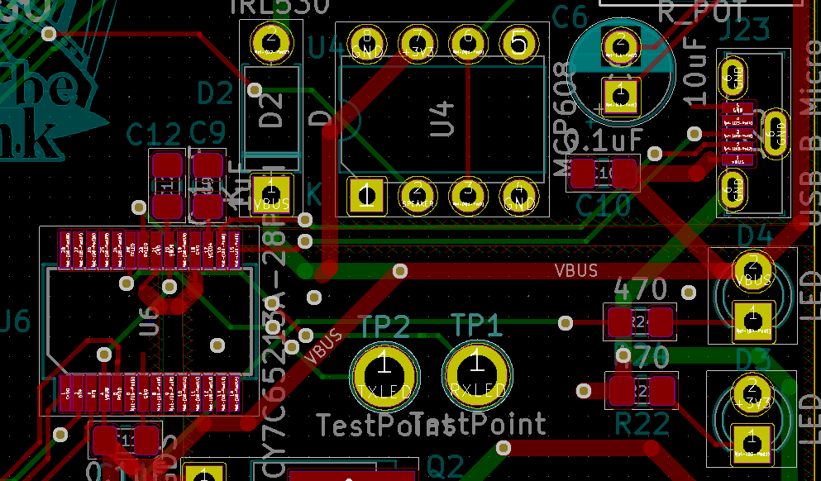
PCB Layout – ESP PCB
SERIAL PROGRAMMER

Slide 47
PCB Layout
Power Considerations
Schematic Subsystem | Maximum Current | Maximum Trace Length | Calculated Trace
ESP32 | 1,100 mA | 10.5 in | 17.5 mils
LEDs (per Grid PCB) | 120 mA | 11.002 in | 14.5
LEDs (total) | 1,920 mA | 8.7 in | 37.8 mils
LCD | 40 mA | 2.7 in | 0.181 mils
Speaker | 460 mA | 2.7 in | 5.27 mils
USB to Serial | 500 mA | 5.9 in | 5.91 mils
Lipo Charger | 550 mA | 5.9 in | 6.74 mils
Motor | 260 mA | 5.89 in | 2.4 mils
3.3V to ESP, Speaker, LCD | 2,420 mA | 10.1 in | 52 mils
5.5V Power Line | 1,310 mA | 6.1 in | 22.3 mils

Slide 48
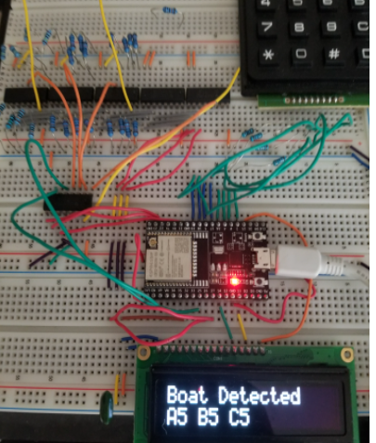
Prototype progress
Circuits Prototyped
Keypad Detection (Complete)
SPI Communication to LCD Board (Complete)
Multiplexer Array Scan (Complete)
Pull-Up Resistor Boat Detection (Complete)
Rumble Motor (Complete)
Speaker Output (In-Progress)
LED Array (Complete)
Power System (Not Started)

Slide 49

Prototype progress
Charger
Backup
Battery
Game Server
2
2
DCDC Converter
LCD
USB
2
SPI
(no MISO)
3
User
Device
2
USB to UART
2
4
Microcontroller
ESP32
1
Rumble Motor
Completion Status
Button Matrix
4x4
8
1
Hardware Only
Firmware &
Hardware
Not Started
Speaker
3
DAC
1
1
Ship Slot 0
8
8x1
Mux0
3
8
LED Daisy Chain 1
…
…
8x1
Mux
…
Ship Slot 63
8
8x1
Mux7
LED Daisy Chain 128

Slide 50
Software development status
Embedded Software Server and API
Keypad Scanning (Complete)
SPI Communication (Complete)
Boat Slot Scanning through Multiplexers (Complete)
Boat Slot Identifying (Complete)
Rumble Motor (In-Progress)
Speaker playing (In-Progress)
Manage Gameflow (Not started)
Parse and send data through Websocket (Not started)
Organize code into full system (Not Started)
LED Array (Complete)
Initialize Websocket Connection (Complete)
Account/DB Requests (In-Progress)
Game AI (Not Started)
Web Game Interface (Not Started)
Create User Account (Complete)
Link MCU Device to Account (Complete)
General Game Flow (Complete)
Friend Requests (Complete)

Slide 51
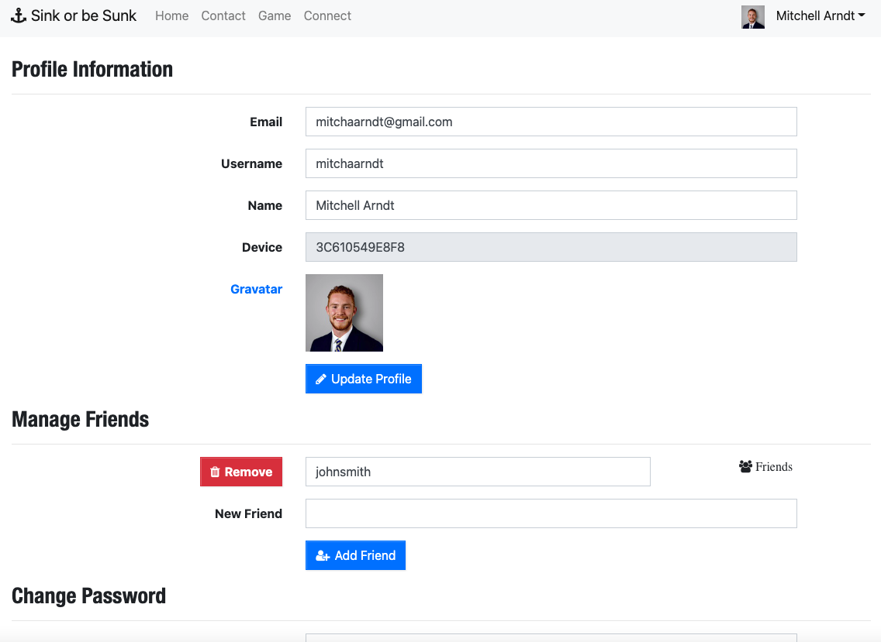
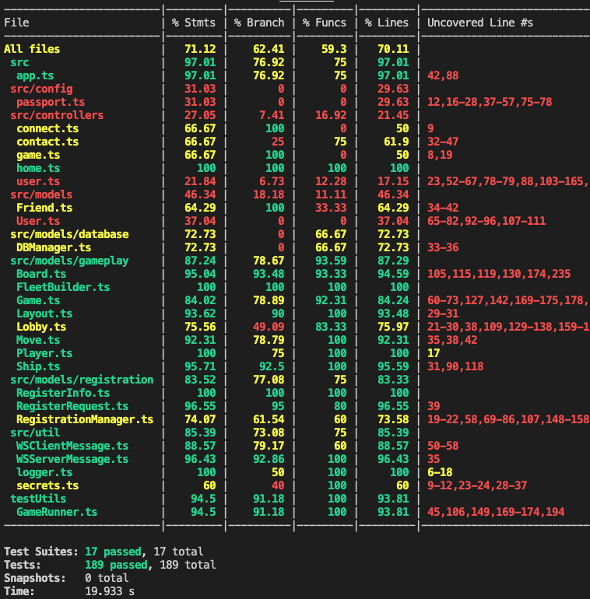
software development status
server account
Jest game flow test cases

Slide 52
Project Timeline
Starting from Midterm Design Review
Task | Week 9 10/18 - 10/22 | Week 10 10/25 - 10/29 | Week 11 11/1 - 11/5 | Week 12 11/8 - 11/12 | Week 13 11/15 - 11/19 | Week 14 11/22 - 11/26 | Week 15 11/29 - 12/3
PCB's Ordered
Circuit Prototyping | Speaker & Power | Speaker & Power | Speaker & Power
Embedded Software Development | Speaker & Motor | Speaker & Motor | Organize Code | Organize code | LED Array
Server Software Development | Web Game Interface | Web Game Interface | Game AI | Game AI | Testing with Physical device
MCU to Server Gameflow communication |  | Finish all MCU to server packets | Receive & parse data from server | Use as full game flow operation | Debugging & testing
PCB Arrival
Order 2nd Board Materials |  | Any Additional | Materials upon | PCB Arrival
1st Board Construction |  |  | Soldering | Soldering & Placement | Full Assembly
2nd Board Construction |  |  |  |  | Soldering & Placement | Full Assembly
Hardware/ Software debugged & implemented |  |  |  | Implement & debug on Board 1 | Implement & debug on Board 1 | Implement & debug on board 2 | Implement & debug on both boards
Testing

Slide 53

3D Printing
Questions?

